Slide 1
Node.js
A Brief Lesson From Yin Bin and Adam Crooks

Slide 2
What is Node.js
Node.js is a single threaded language which in background uses multiple threads to execute asynchronous code.
Node.js is non-blocking which means that all functions ( callbacks ) are delegated to the event loop and they are ( or can be ) executed by different threads. That is handled by Node.js run-time.

Slide 3
Some facts about Node.js
Node.js supports forking multiple processes, which are executed on different cores .
State is not shared between master and forked process.
We can pass messages to and from a forked process ( which is different script) from the Master Process

Slide 4
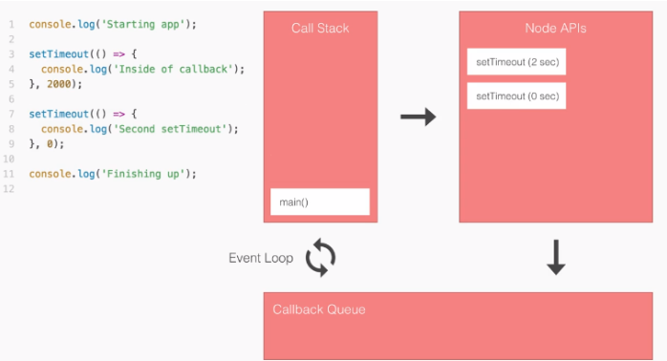
Event loop

Slide 5
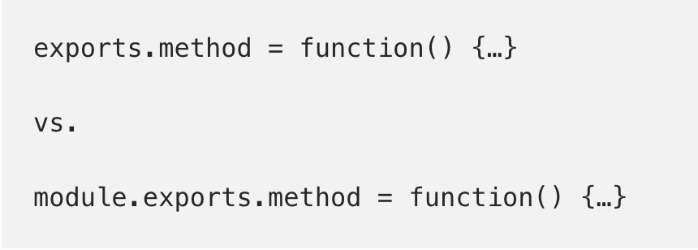
MODULE.EXPORTS VS EXPORTS
Think of module.exports as the variable that gets returned from require(). It is an empty object by default, and it is fine to change to anything.
Exports? Well, “exports” itself is never returned! It is just a reference to module.exports; a convenience variable to help module authors write less code. Working with its properties is safe and recommended.

Slide 6
Why and when we need to fork another process?
Forking multiple processes is essential for freeing up memory and unloading single process.
When we need to delegate tasks ( run them in parallel ) to another process for the sake of the speed.

Slide 7
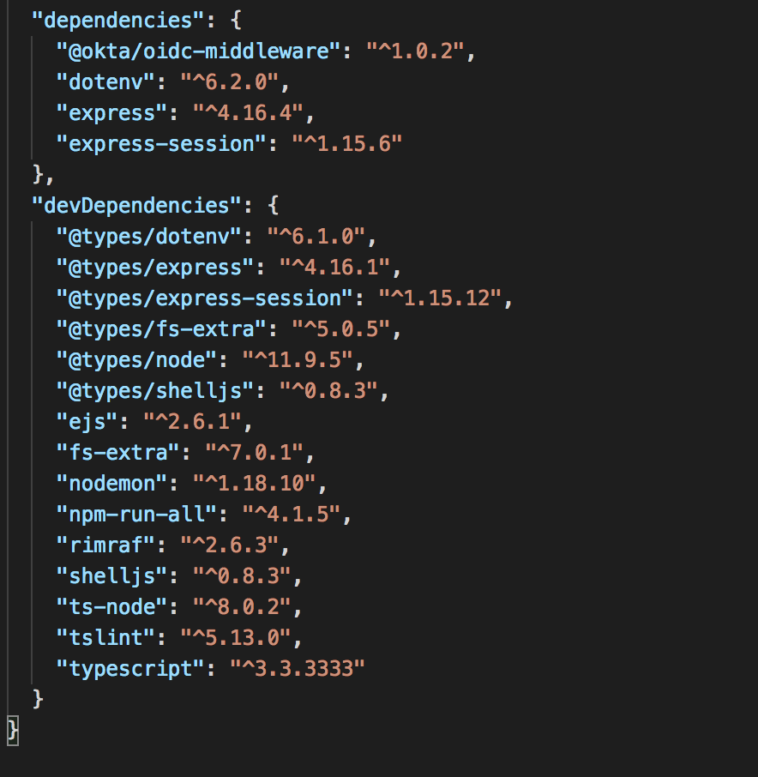
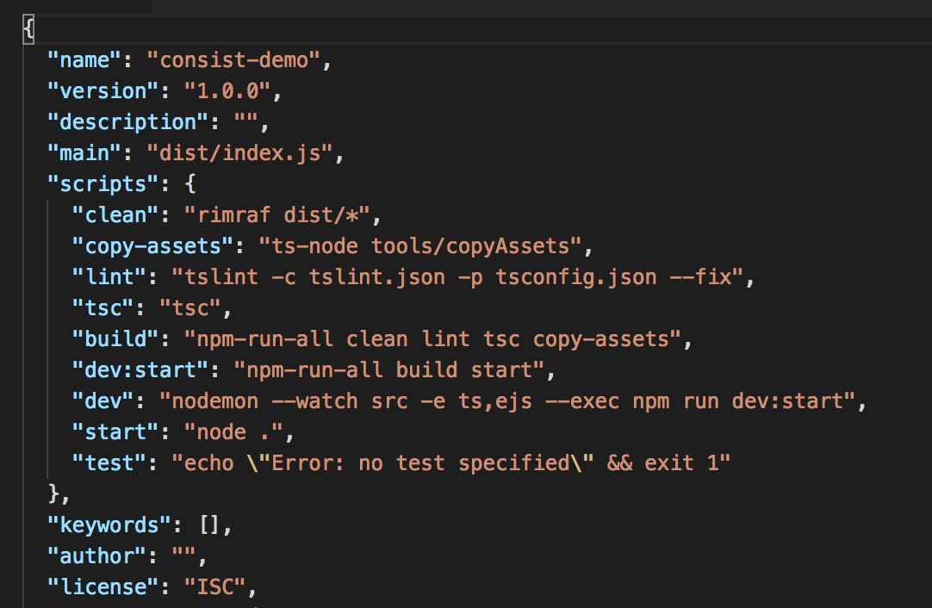
package.json

Slide 8
Why and when we need to fork another process? (Code Snippet)
const { fork } = require('child_process');app.get('/endpoint', (request, response) => { // fork another process const process = fork('./send_mail.js'); const mails = request.body.emails; // send list of e-mails to forked process process.send({ mails }); // listen for messages from forked process process.on('message', (message) => { log.info(`Number of mails sent ${message.counter}`); }); return response.json({ status: true, sent: true }); });
async function sendMultipleMails(mails) { let sendMails = 0; // logic for // sending multiple mails return sendMails; }// receive message from master process process.on('message', async (message) => { const numberOfMailsSend = await sendMultipleMails(message.mails); // send response to master process process.send({ counter: numberOfMailsSend }); });

Slide 9
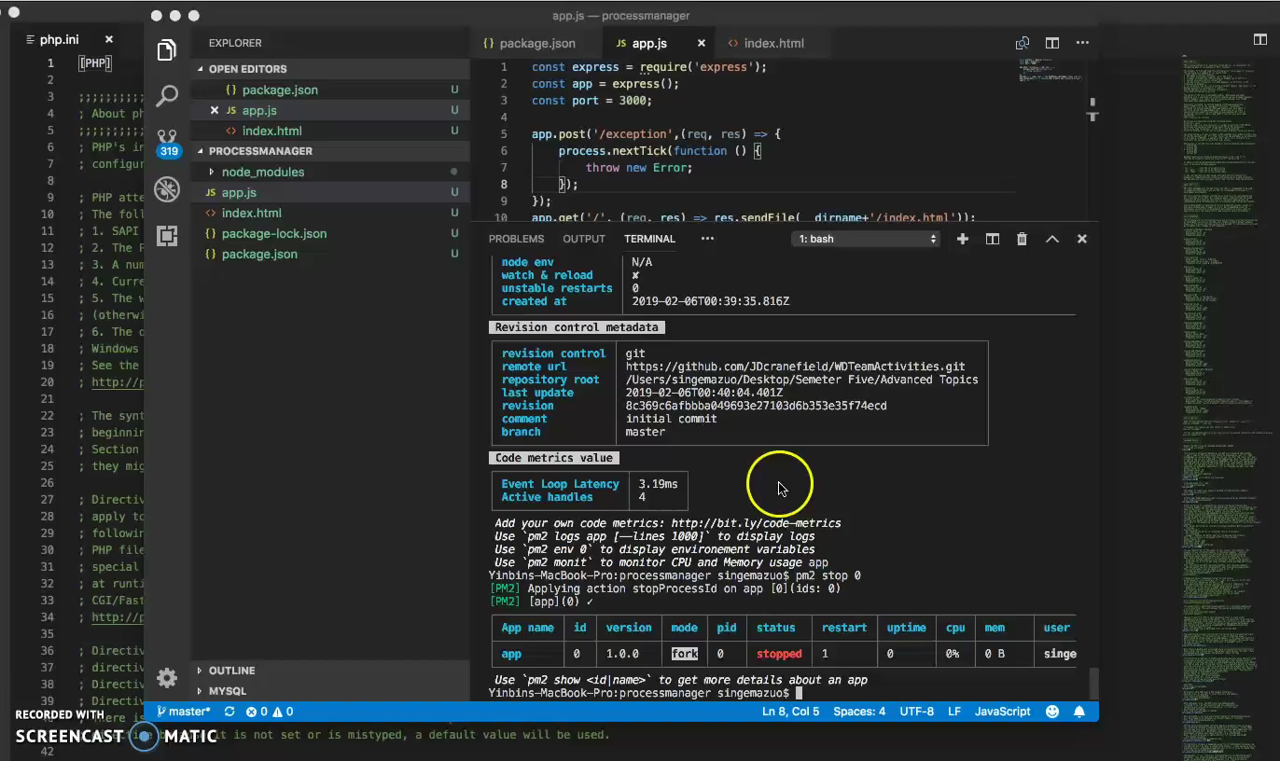
Demo for your viewing pleasure

Slide 10
Express JS
Express.js is a web application framework for node.js designed to help with building web applications, and APIs using javascript.
It encapsulates many functions and solutions for Node, allowing dev’s to simply the overall development cycle.
Express.js also provides rich APIs for web development

Slide 11
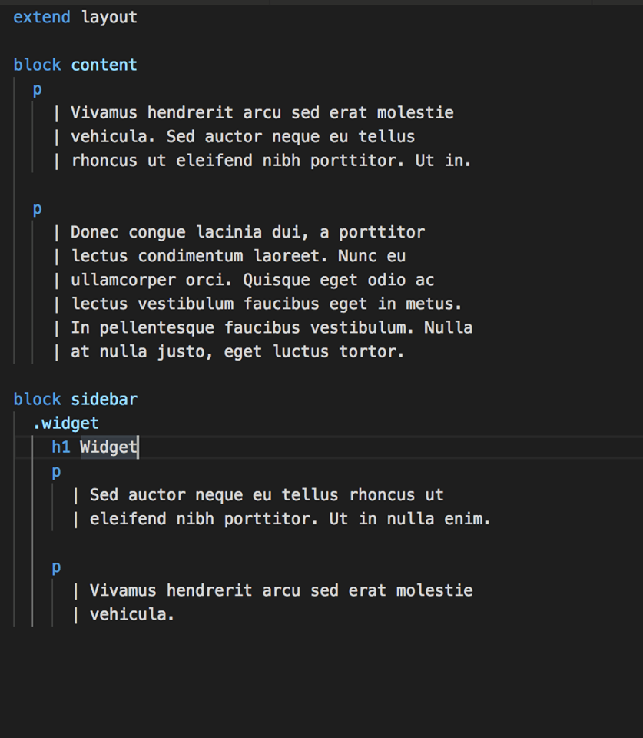
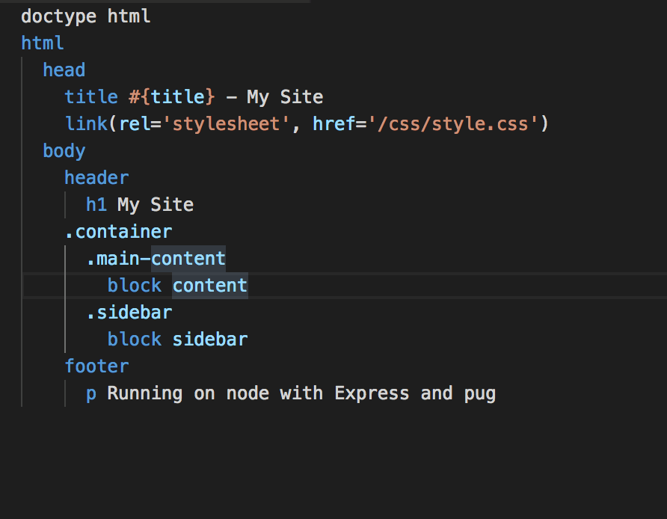

Slide 12
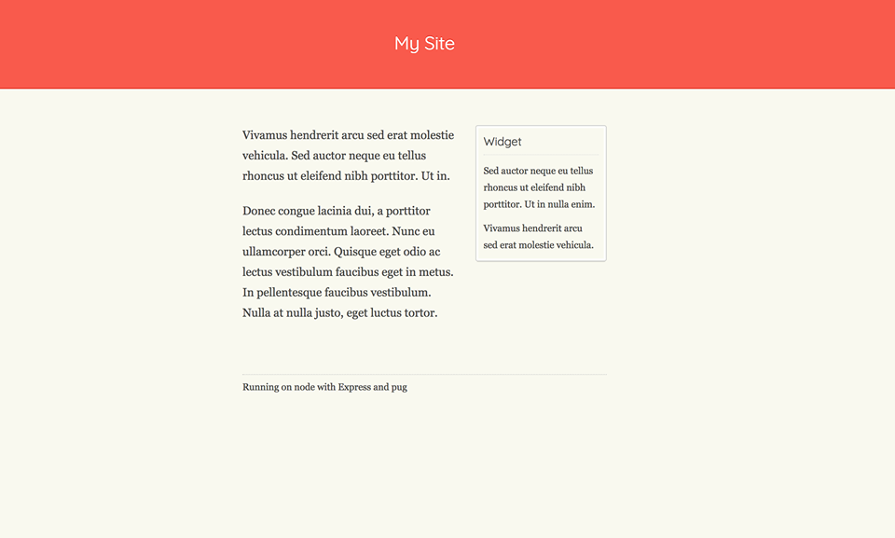
End Product

Slide 13
Mongo db
High Performance
MongoDB provides high performance data persistence. In particular,
Support for embedded data models reduces I/O activity on database system.
Indexes support faster queries and can include keys from embedded documents and arrays.
High Availability
MongoDB’s replication facility, called replica set, provides:
automatic failover and
data redundancy.
A replica set is a group of MongoDB servers that maintain the same data set, providing redundancy and increasing data availability.
Horizontal Scalability
MongoDB provides horizontal scalability as part of its core functionality:
Sharding distributes data across a cluster of machines.
MongoDB supports creating zones of data based on the shard key. In a balanced cluster, MongoDB directs reads and writes covered by a zone only to those shards inside the zone.

Slide 14
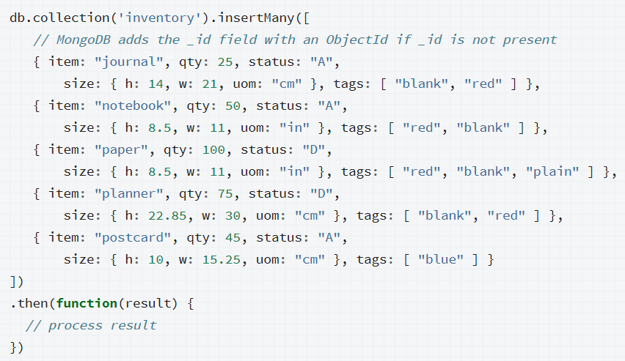
Mongo cont.
The following example inserts new documents into the inventory collection

Slide 15
nginx
Works as a pipeline allowing users to move between projects.

Slide 16
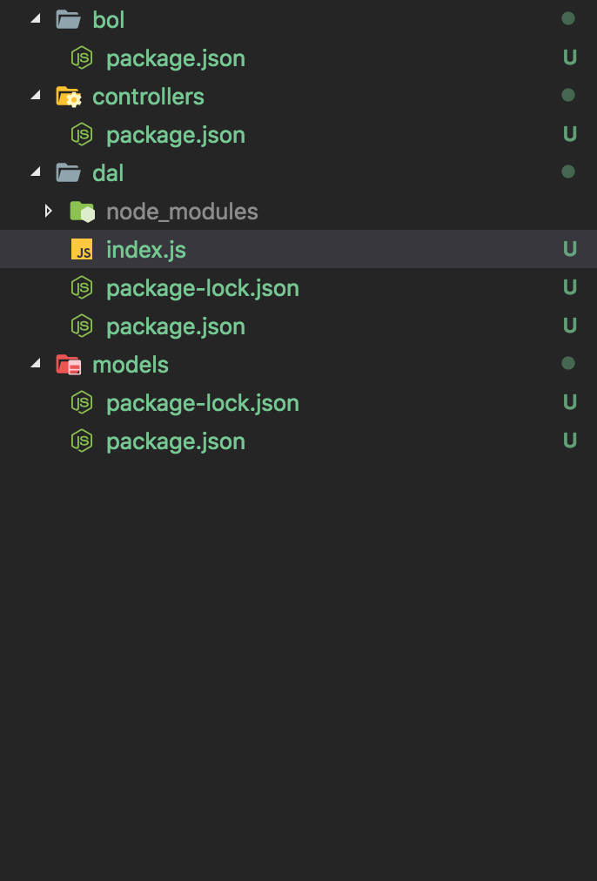
more features:
n-tIER APPLICATION
Create custom modules for an N-Tier Application
create a new directive
initialize a package.json
complete coding & publishing
Deploy various services for N-Tier Application

Slide 17
more features:
aUTOMATed DEPLOYMENT
Coding webhook script
Coding shell script for executing processing manage programming
Config webhook on Git

